Slide 1
Detecting Aerodynamic Stall - Team Machine
George Mason University
DAEN690 - Data Analytics Engineering Project
Authors: Sean Case, Jake Ryan, Adam Ferguson, Ajay Kurian

Slide 2


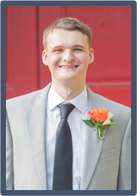

TEAM MACHINE
Introducing Our Members
Sean Case
Scrum Master
Jake Ryan
Product Owner
Adam Ferguson
Developer
Ajay Kurian
Developer
Notes:
All

Slide 3
Problem Statement
Solution
Importance
Aerodynamic stall events are fairly rare events where influxes of turbulence reduces the flight-enabling lift force for a plane. This can lead to an airline crash.
Machine learning can be used to detect stall events based on conditions such as buffet, uncommanded descent and roll (among others).
A programmatic means is needed to inform pilots to take corrective action to eliminate or mitigate risk.
Aerodynamic stall has been a contributing factor behind numerous flight disasters in the past decade.
Stall is condition that affects both military and civilian aircraft and and, due to its relative rarity, requires accurate and timely detection to enable pilots to take decisive and timely action.
Notes:
Adam

Slide 4








Storyboard - How would our end state solution work?
Plane is in flight
All controls look good.
Pilots are relaxed
Onset of buffet. No worry to pilots
Onset of stall begins
Algorithm is triggered and stall is event is detected
Stall event triggers notification that is broadcast to pilot
Pilots take appropriate action to avoid stall (either applying thrust or diving)
Stall event avoided. Plane is still in flight
Images made by Flat Icons from www.flaticon.com
Notes:
Adam

Slide 5
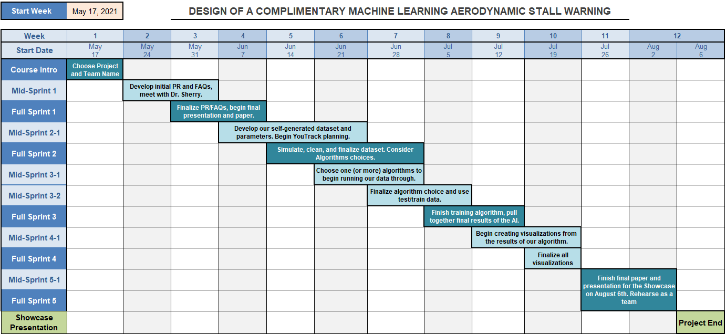
TEAM MACHINE – PROJECT SCHEDULE
Notes:
Adam

Slide 6
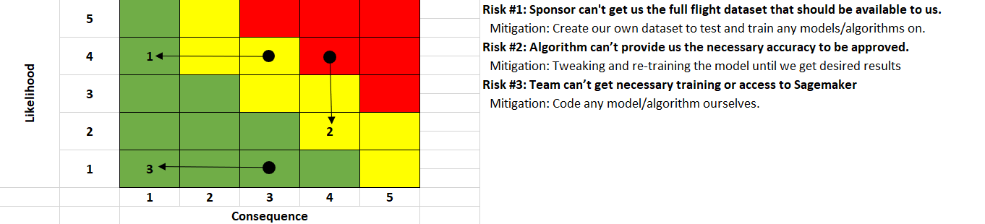
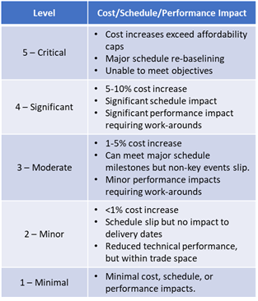
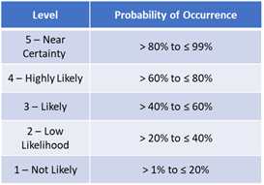
TEAM MACHINE – RISKS AND PLANNED MITIGATIONS
Notes:
Adam

Slide 7
Dataset - Simulated Synthetic Flight Data
Aviation data is oftentimes tightly regulated and not easily accessible. For the purposes of this project, synthetic data will be generated using parameters and guidelines provided by subject matter experts (SMEs) in this domain.
Data Assessment:
Completeness: Our dataset has no null values and every row is populated with a value
Uniqueness: They are not all unique, by nature of using randomly distributed normal variables we will expect to have some duplicate values in some of our records.
Accuracy: All data values in our dataset are based on calculations and documentation provided to us by Dr. Sherry (SME). They are all consistent, unambiguous, and therefore, correct.
Conformity: Since this is a self generated dataset the main area of concern is whether the generated values conform to what is reasonable in a real-world flight scenario.
Overall Quality: With the formulas provided, the team asserts that the quality of the dataset is high. The data conforms to the guidelines outlined by Dr. Sherry.
Notes:
Adam

Slide 8
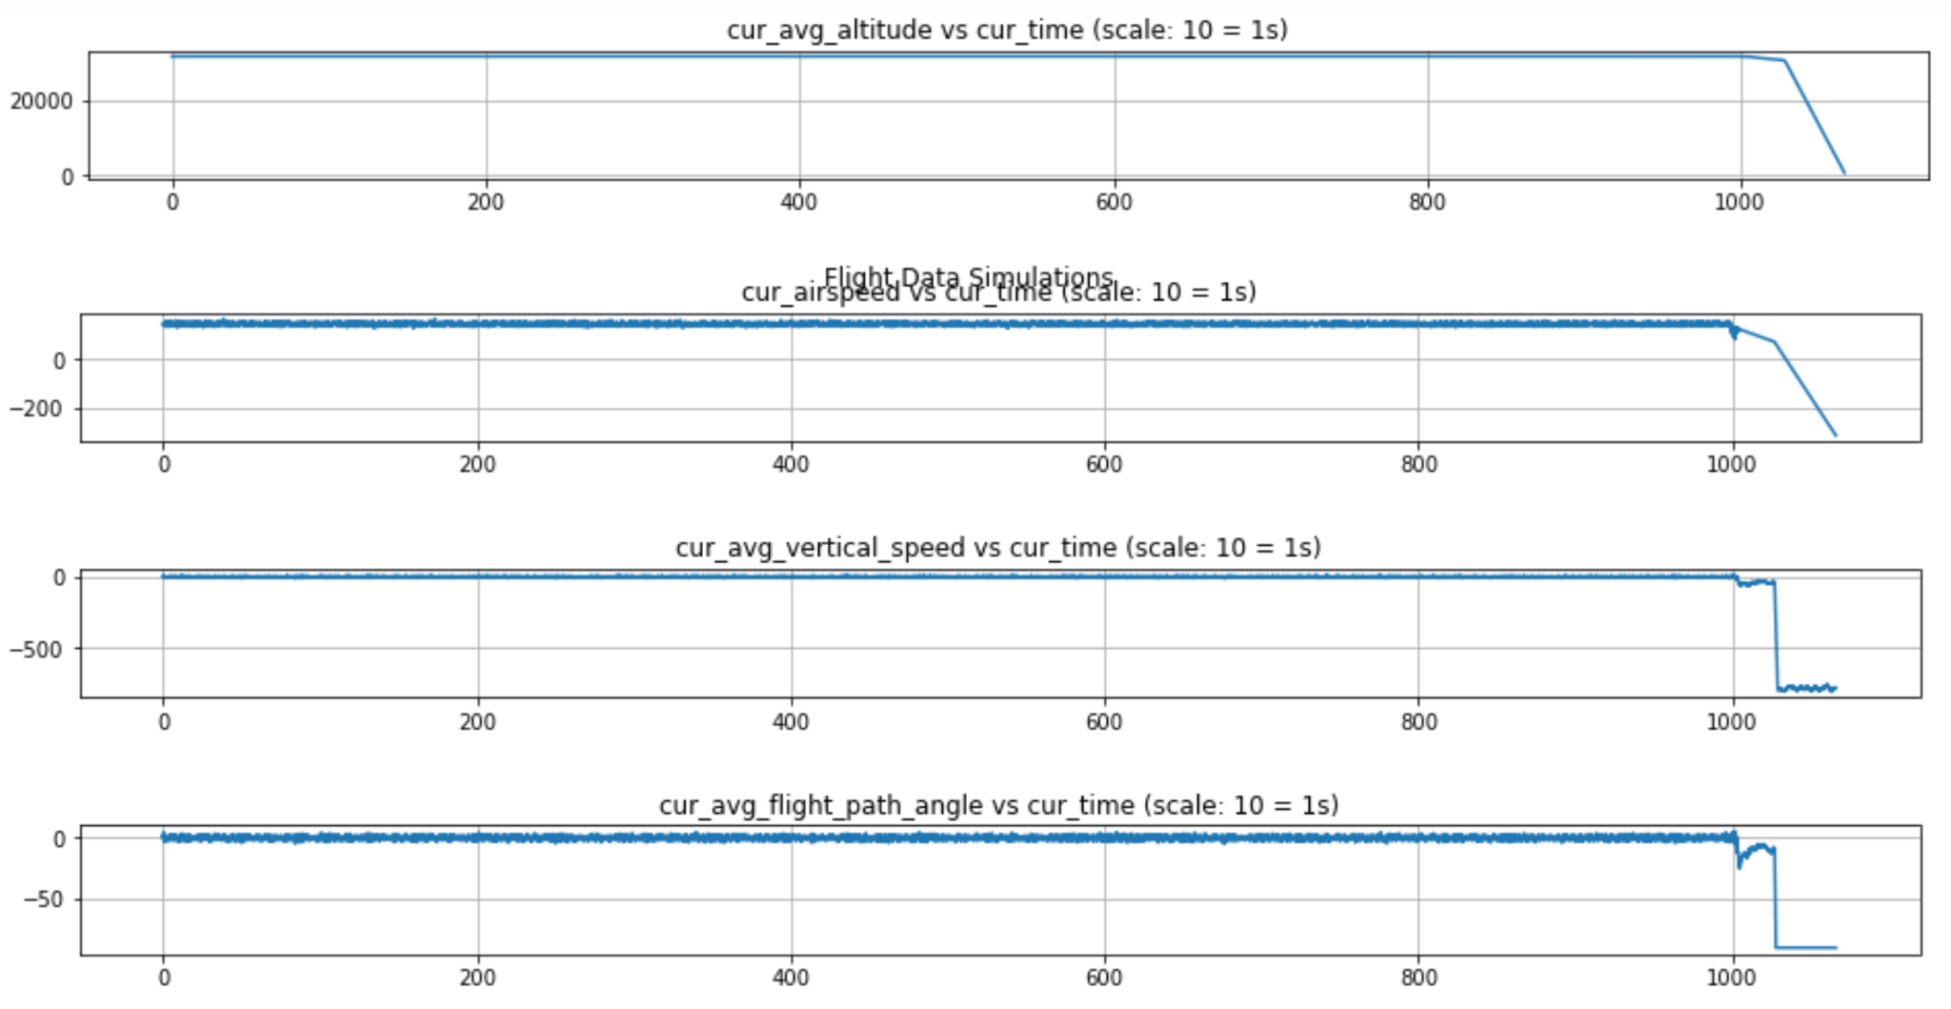
Data Visualizations
Notes:
Sean

Slide 9
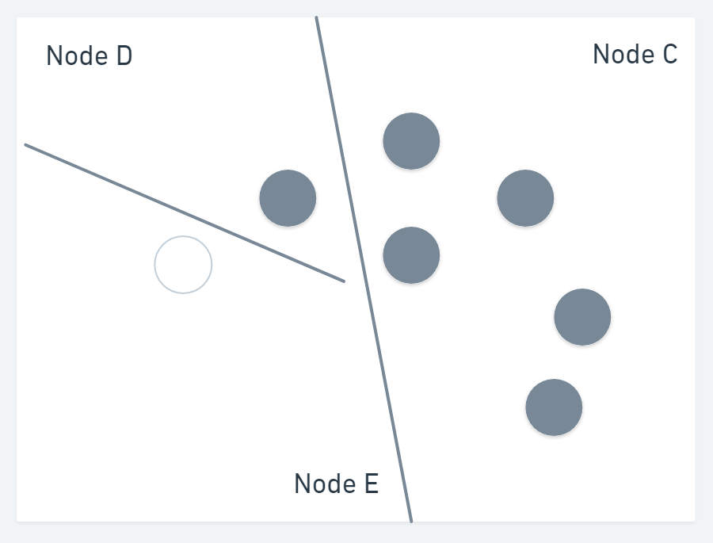
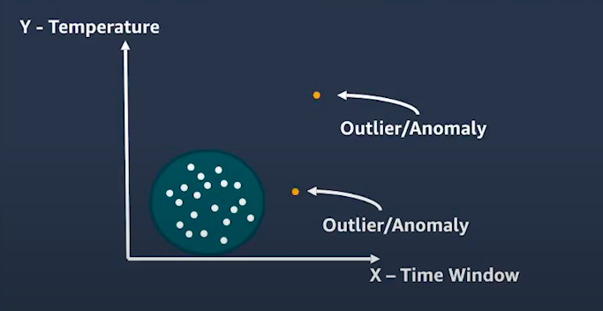
Random Cut Forest: AWS SageMaker
Humans are proficient at identifying data points that seem to be anomalies, however the RCF algorithm can detect anomalies the human eye can not see.
It detects them by building multiple decision trees, known as a Forest of Trees, to track how newly added data points affect the forest.
Each anomaly in the data is assigned a score by the RCF algorithm by calculating the mean score from each of the decision trees and appropriately scaling the output by the sample size.
All anomaly scores from the different models are combined, due to the individual models being weak identifiers on their own, and a final anomaly score is calculated.
Amazon Sagemaker pinpoints anomalous data points when the score of the data point is statistically significantly dissimilar from other points in the models.
A random cut forest (RCF) is a modified version of a random forest (RF) algorithm.
RCF was developed by AWS and is an unsupervised algorithm
The RCF algorithm was built to provide quick incremental updates with the use of variables in the tree construction.
RCF relies on cluster analysis to discover data outliers, cuts in seasonality or periodicity, and to identify anomalies in time series data.

Slide 10
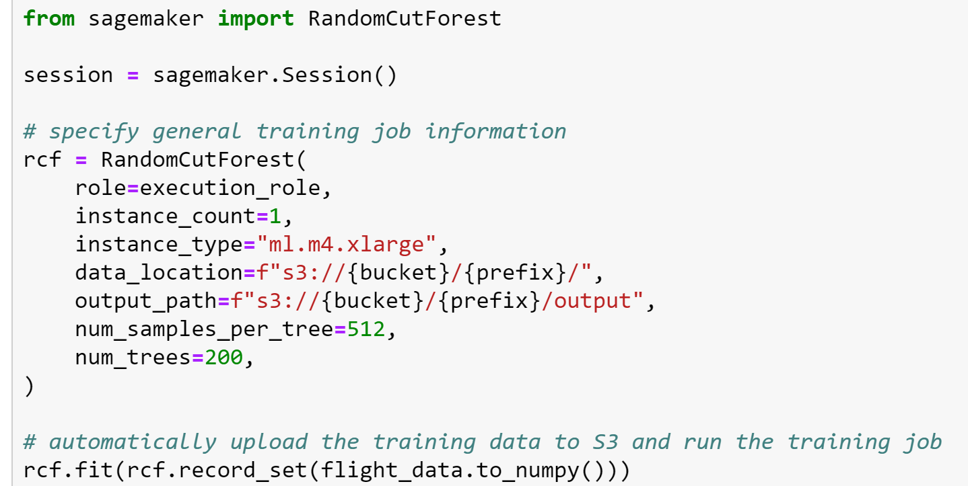
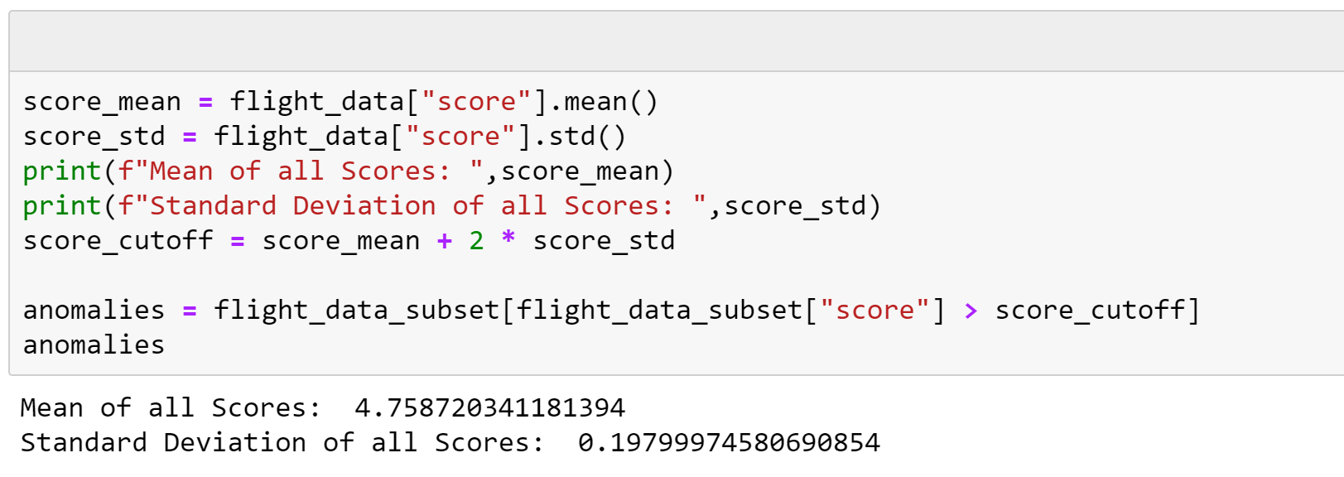
Random Cut Forest: Continued
We import the Random Cut Forest algorithm from SageMaker and add initial hyperparameters and instance types.
Optimize the hyperparameters.
AWS provides a tool for Automatic Model Tuning
Here we see the output of the model once it is finished training on our dataset.
We can see the mean and standard deviation of all the data point scores.
We have chosen 2 standard deviations (approx 95% percentile) from the mean score.
3 is usually recommended, but we wanted our model to be more sensitive as a false positive is not a bad thing for this problem.

Slide 11
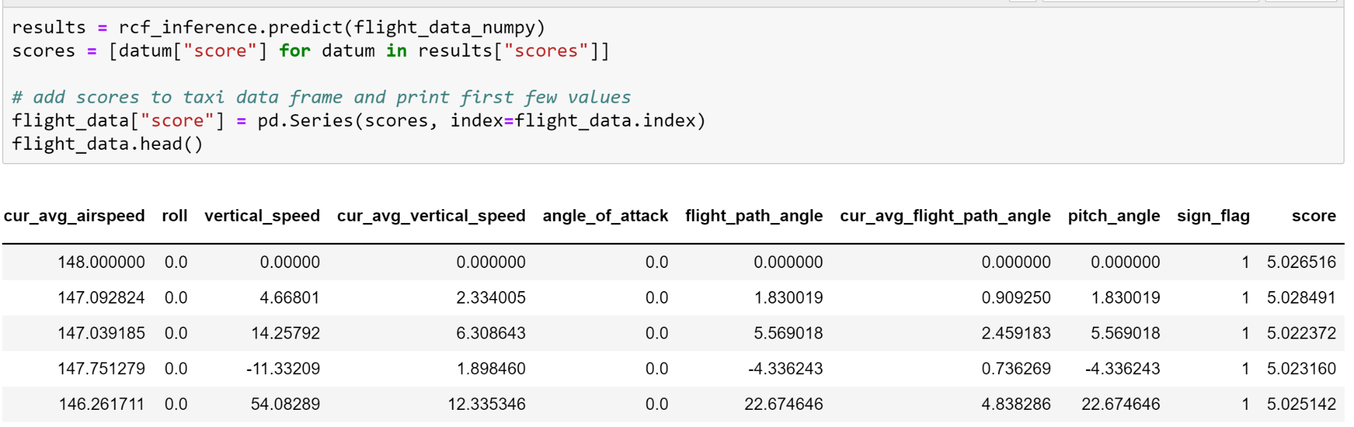
Random Cut Forest: Continued
The RCF algorithm calculates an anomaly score metric by calculating the mean score from each of the decision trees and appropriately scaling the output by the sample size.
The score values are extracted into a score list before being added to the flight dataset.
The resulting image shows the first few rows with the anomaly scores generated from RCF

Slide 12
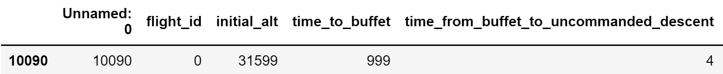
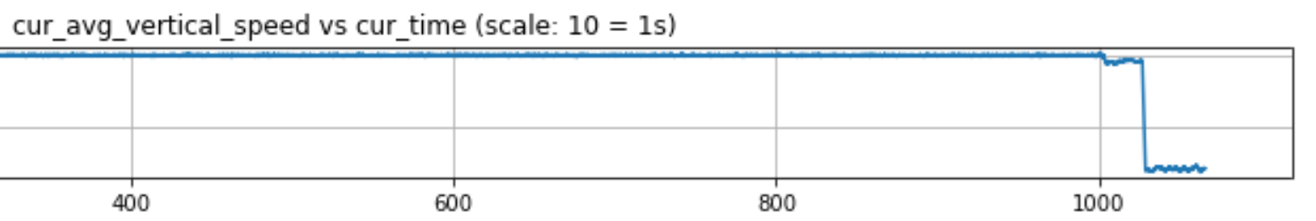
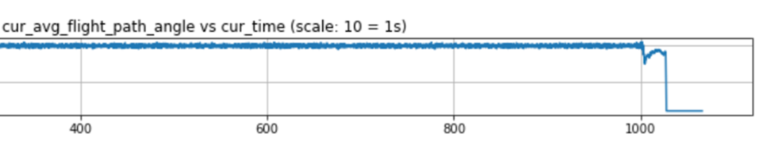
Random Cut Forest: Results

Slide 13
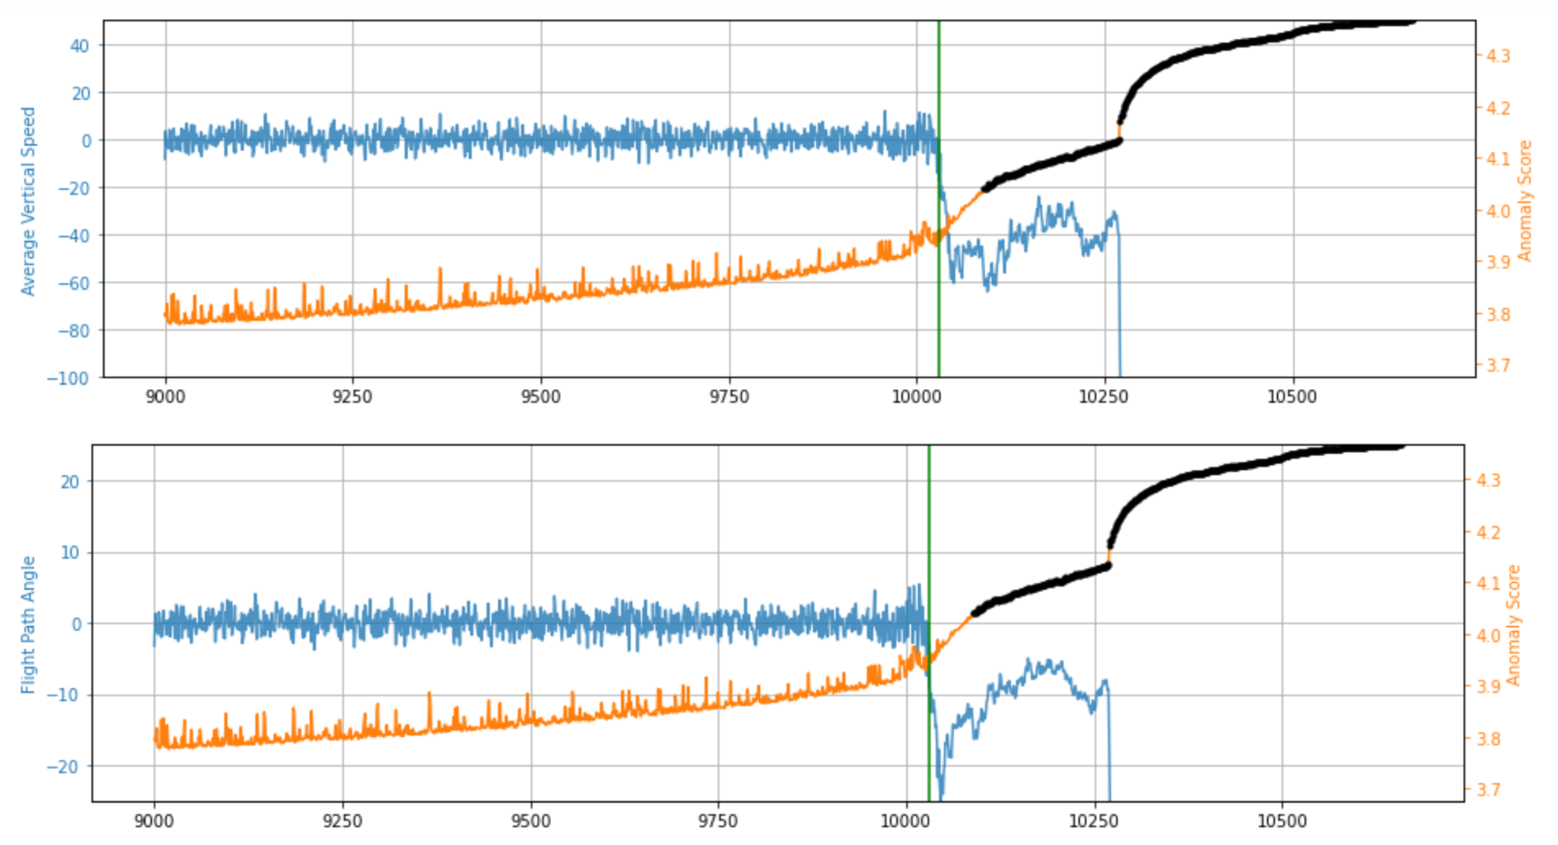
Random Cut Forest: Results

Slide 14
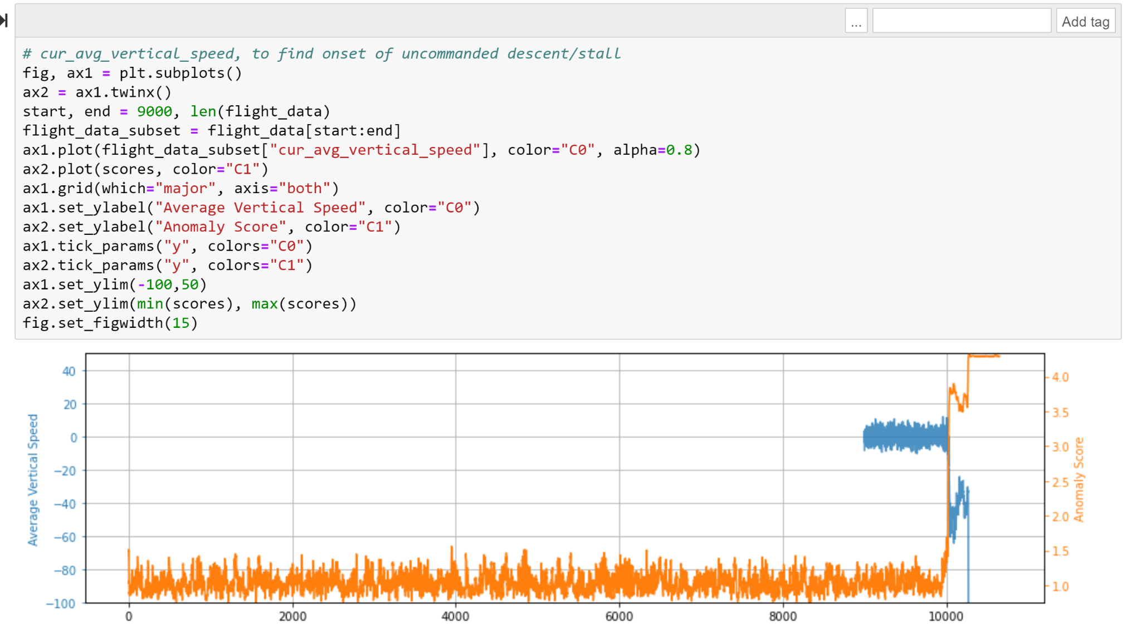
RCF: Shingling
Shingles result in the anomaly detection running over vectors of data rather than single data points, which smooths the data for minor fluctuations.

Slide 15
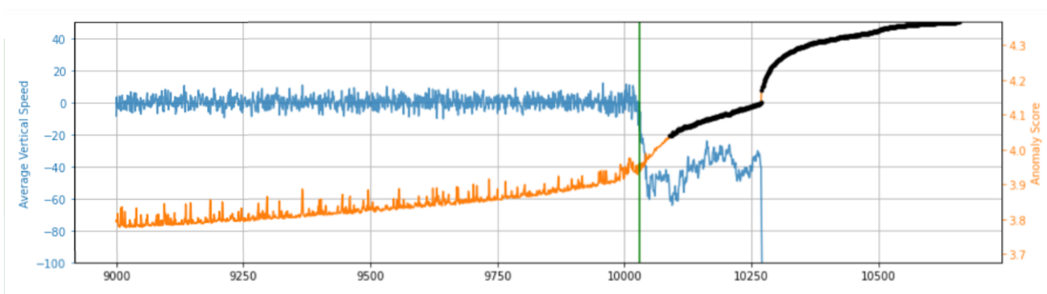
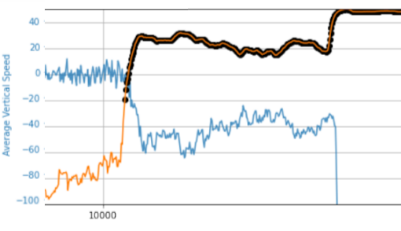
RCF vs RCF + Shingling: Model Comparison
Onset of Stall: 999 seconds
Stall: 1,027 seconds
Time between: 28 seconds
RCF Detection: 1,010 seconds
Time to Stall: 17 seconds
RCF + Shingling Detection: 1,003 seconds
Time to Stall: 24 seconds
IMPROVEMENT: 7 seconds (41% increase lead time)

Slide 16
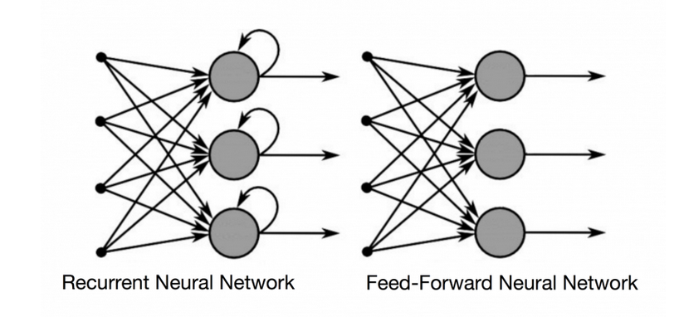
DeepAR Algorithm
DeepAR is a supervised learning algorithm for forecasting scalar (one-dimensional) time series using recurrent neural networks (RNN).
A traditional feed-forward neural network architecture consists of three layers:
The input layer consists of the data that is fed to the model.
The hidden layer is where the inputs are multiplied by a weight value then summed up to get a sum of weighted values.
The sum of weighted values are fed into an activation function which is used to forecast an output value (which occurs in the output layer).
A loss function calculates the gradient between the model output and the actual output and propagates this loss back to the hidden layer. The parameters and hyperparameters in the hidden layer are tuned to reduce the loss function.
This is a concept known as backpropagation and is the mechanism by which a neural network “learns” from data.
A recurrent neural network adds a looping mechanism that allows previous information, represented through a hidden state, to influence future layers. In contrast, feed-forward networks only move forward and have no memory of the input that they receive.

Slide 17
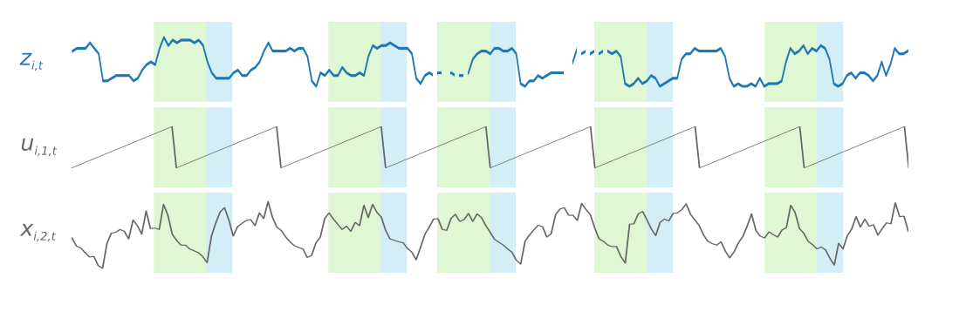
DeepAR Algorithm
Input: One or more target time series generated through the same or similar process
Each training example consists of a pair of adjacent context (how far in the past to look) and prediction windows (how far in the future to predict) with fixed predefined lengths
Model: Trains on random windows of input data (including context and prediction windows) to create a global model to identify patterns.
Output: Utilizes Gaussian binomial likelihood to produce a probabilistic forecast of values equal to the prediction window
Example from Sagemaker Documentation

Slide 18
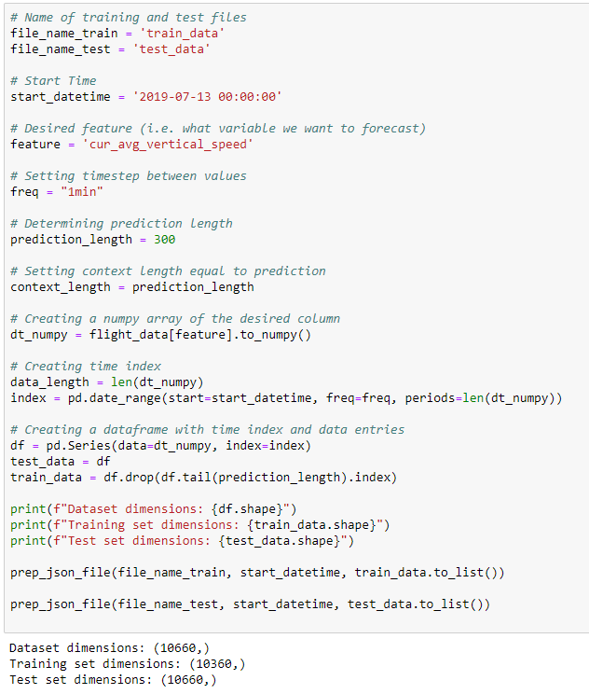
DeepAR - Training
The training data needs to be in JSONLines format as follows:
{"start": "2009-11-01 00:00:00", "target": [4.3, "NaN", 5.1, ...]}
{"start": "2012-01-30 00:00:00", "target": [1.0, -5.0, ...]}
{"start": "1999-01-30 00:00:00", "target": [2.0, 1.0]}
There is a start timestamp (Start) with a frequency timestep to determine the timestamp of each data point
Problem: The smallest granularity allowed by the frequency hyperparameter is minutes
Currently, our dataset uses 0.1s timesteps between each row.
The model does not support non-integer values before the “minutes” value (ex: 0.00167 minutes)
Conclusion: We have decided to run the model using 1min timesteps to see its forecasting ability and incorporate our findings into our final paper
Note: In an operational setting, this limitation in granularity is a blocker in the current implementation of the algorithm

Slide 19
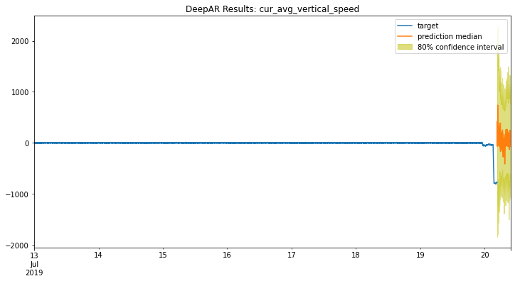
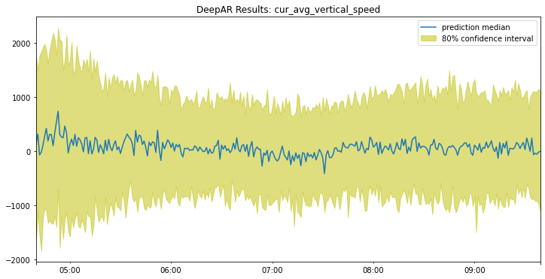
DeepAR - Testing
The context window is 300 min and the prediction window is 300 min
Trained the algorithm using a subset of the data while removing the prediction_window
i.e. data[-prediction_window :]
Deployed endpoint, built test data object and posted test data to endpoint with the output type being a quantile range (between 0.1, 0.5, and 0.9)
Adjacent results show the prediction median (column: 0.5) with the 10th and 90th percentile (columns 0.1 and 0.9)
Future enhancements to model would be to train with multiple time series data simulations to enable the model to recognize more patterns

Slide 20
Findings
Creating synthetic data required many iterations and discussions with the partner.
Between RCF and DeepAR, we determined the anomaly detection algorithm served our use case better.
When trained correctly, machine learning algorithms are able to detect onset of stall earlier and provide more time to the pilots.
While DeepAR is limited in granularity, other neural network algorithms (LSTM) could prove useful in future studies.
Notes:
DeepAR could only go as granular as minutes, which did not mesh with our data points being created every 1/10th of a second.
RCF provided on average 17-18 seconds of advanced notice for them to perform the necessary corrective actions.

Slide 21
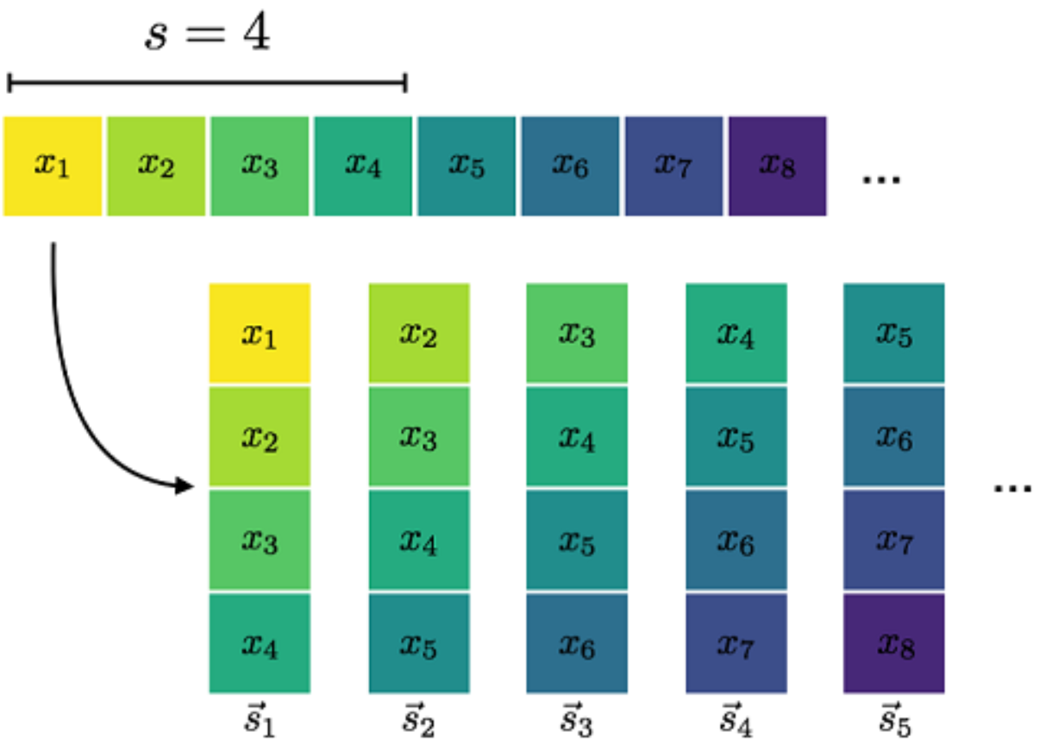
Future Work
Explore Shingling more in depth for the RCF Model. Especially useful when using data with a known time period.
Only worked on our dataset when we specified one variable to shingle at a time.
With this approach we noticed a
significant (~40%+) improvement in
detecting the onset of stall.
For DeepAR, look into ways to
achieve more granularity, as well
as investigate tuning opportunities
with multiple variables.

Slide 22
Questions?

